Slide 1
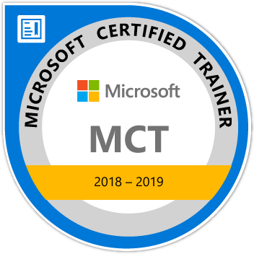
Learn ASP NET CORE
Maruti Makwana
Microsoft Certified Trainer
www.microsofttrainer.in

Slide 2



Slide 3
Azure
Dot Net Core
Dot Net
Pipeline
Ado.Net
MVC
Code First
approach
C#
Middleware
SQL
TAG Helper
LINQ

Slide 4
What is ASP.Net Core?
How it is different from
ASP Dot Net Framework?

Slide 5
What is ASP .Net Core?
ASP.NET Core is an open source and cloud-optimized web framework for developing modern web applications that can be developed and run on Windows, Linux and the Mac.
It includes the MVC framework, which now combines the features of MVC and Web API into a single web programming framework.

Slide 6
Why to choose ASP. Net Core?
ASP.NET Core is an open source and cloud-optimized web framework for developing modern web applications that can be developed and run on Windows, Linux and the Mac.
It includes the MVC framework, which now combines the features of MVC and Web API into a single web programming framework.
ASP.NET Core apps can run on .NET Core or on the full .NET Framework.
It was architected to provide an optimized development framework for apps that are deployed to the cloud or run on-premises.

Slide 7
Why to choose ASP. Net Core?
ASP.NET Core apps can run on .NET Core or on the full .NET Framework.
It was architected to provide an optimized development framework for apps that are deployed to the cloud or run on-premises.
Built-in support for dependency injection.
Tag Helpers which makes Razor markup more natural with HTML.
The benefits of a smaller app surface area include tighter security, reduced servicing, improved performance, and decreased costs

Slide 8
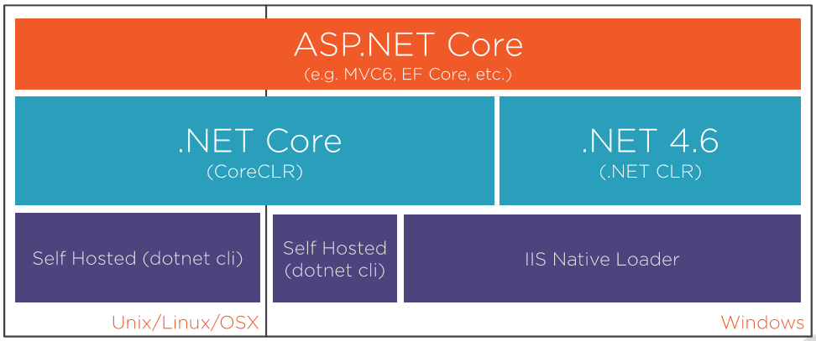

Slide 9
What is MVC?
MODEL
VIEW
CONTROLLER

Slide 10
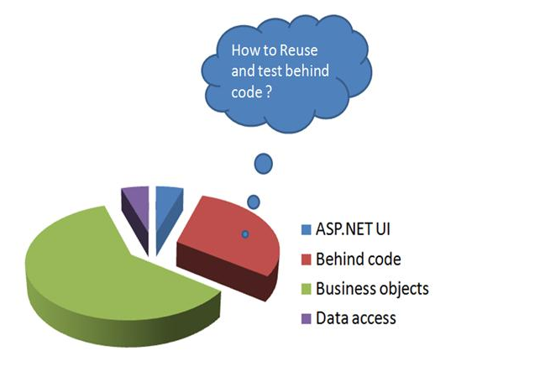
Why MVC ?

Slide 11
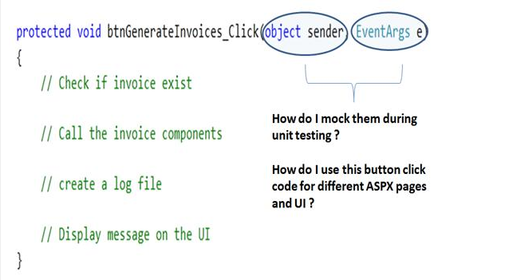

Slide 12
What is difference between Asp.Net Web application and MVC web application?

Slide 13
What is MVC 6?
Which is based on dot net core framework
NOT on dot net framework

Slide 14




Required Tools and Software
Google Chrome

Slide 15
Can I develop MVC 6/Dot net core application
Without Visual studio?
Yes BUT----- nobody is doing like that

Slide 17
Before ASP.Net Core let’s See.Net Core

Slide 18
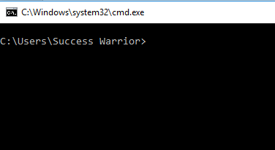
Let’s Understand dotnet code with simple application
Open
Command
prompt

Slide 19
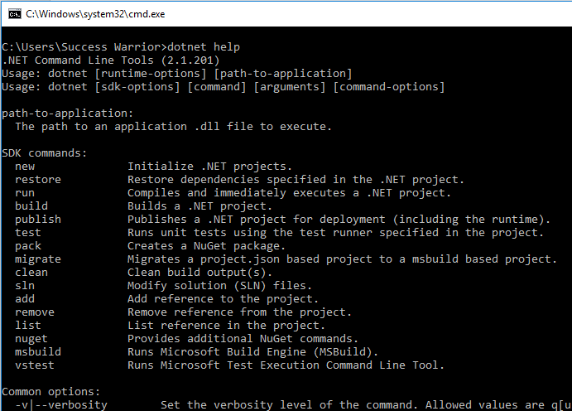

Slide 20
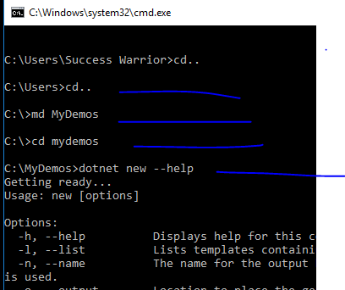

Slide 21
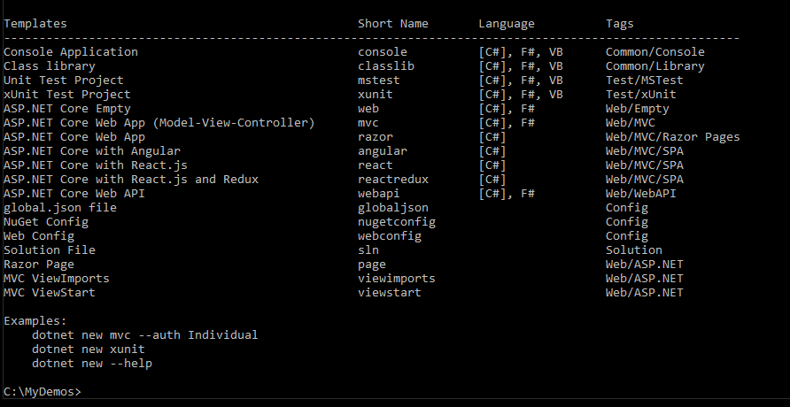
We can create any of these projects using dotnet command

Slide 22
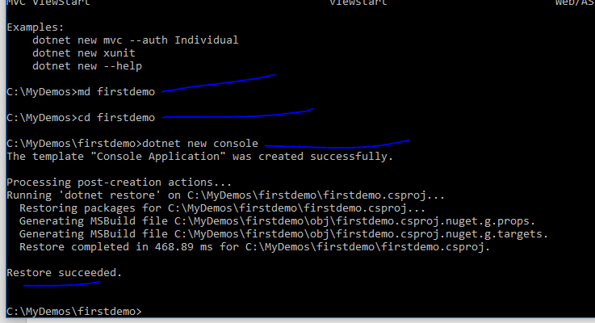
We created new console applicaiton

Slide 23
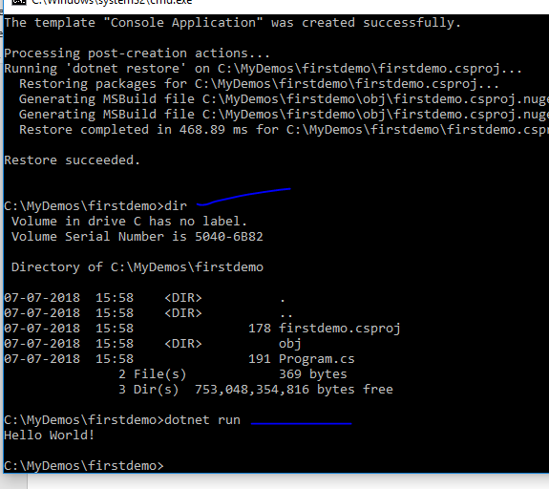
We got new project with very simple project
And its running

Slide 24
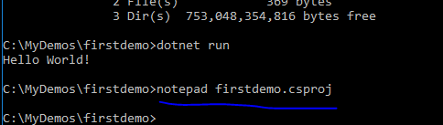
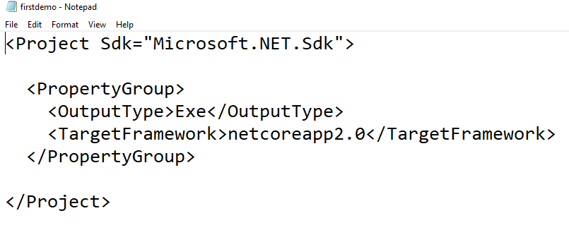
A very simple
csproj file

Slide 25
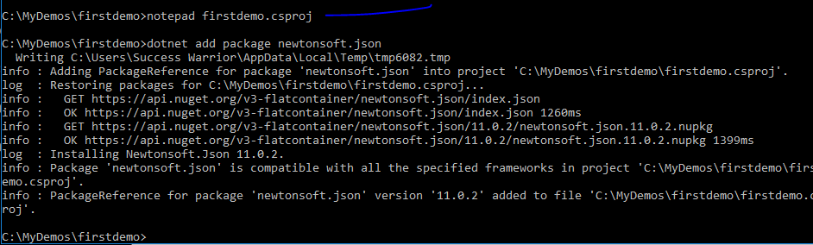
Adding new package using npm

Slide 26
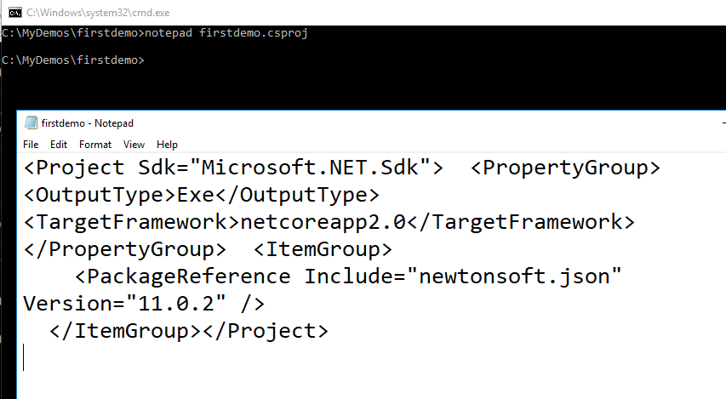
Csproj file will get changed and package is added

Slide 27
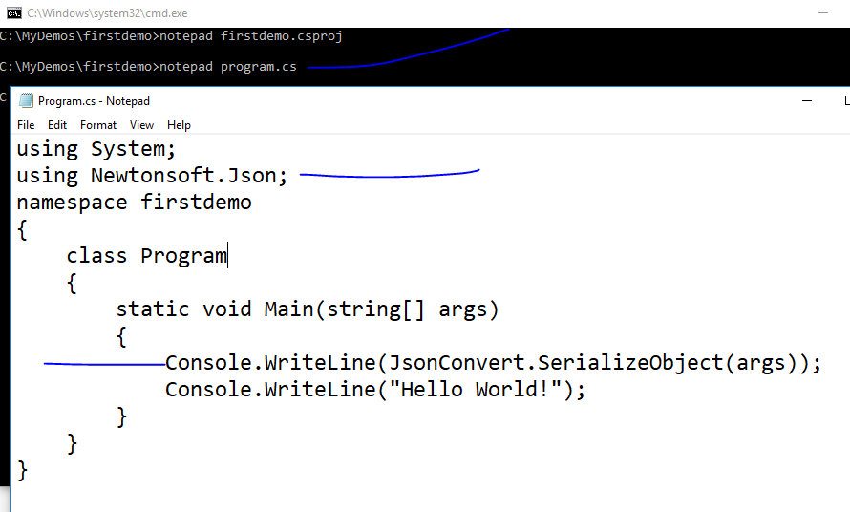

Slide 28
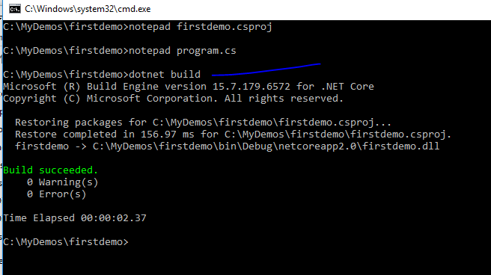

Slide 29
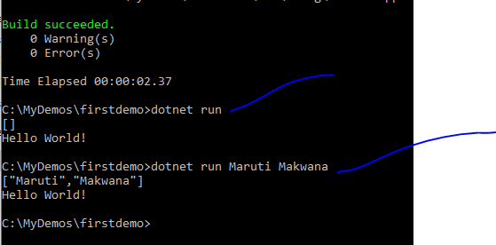

Slide 30
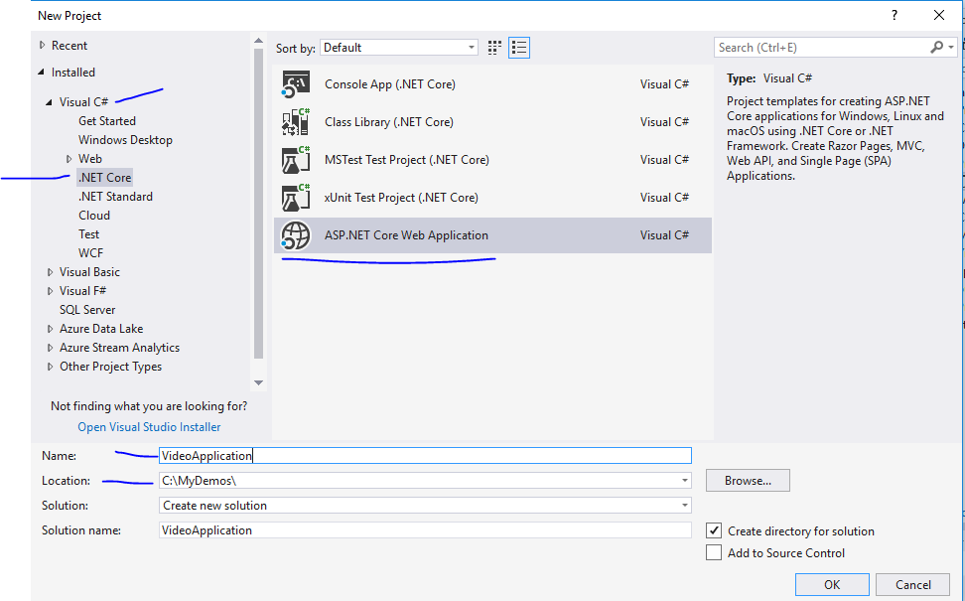

Slide 31
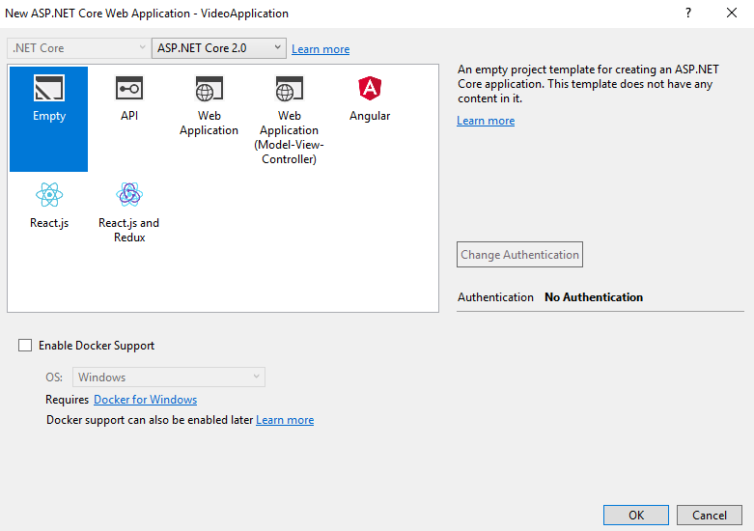

Slide 32
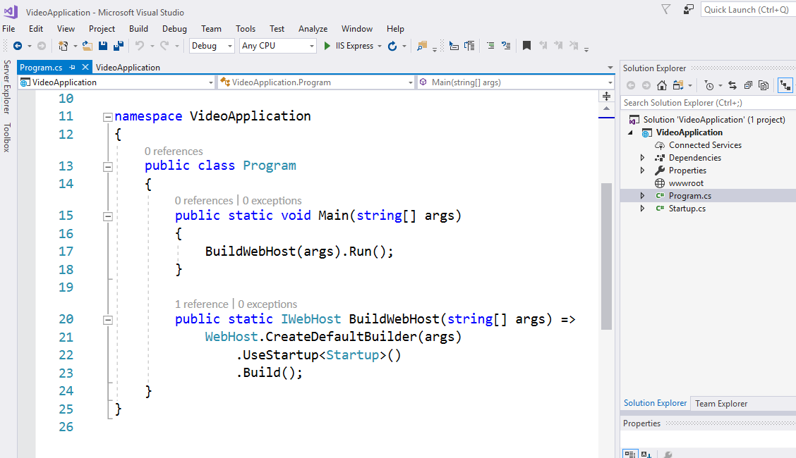

Slide 33
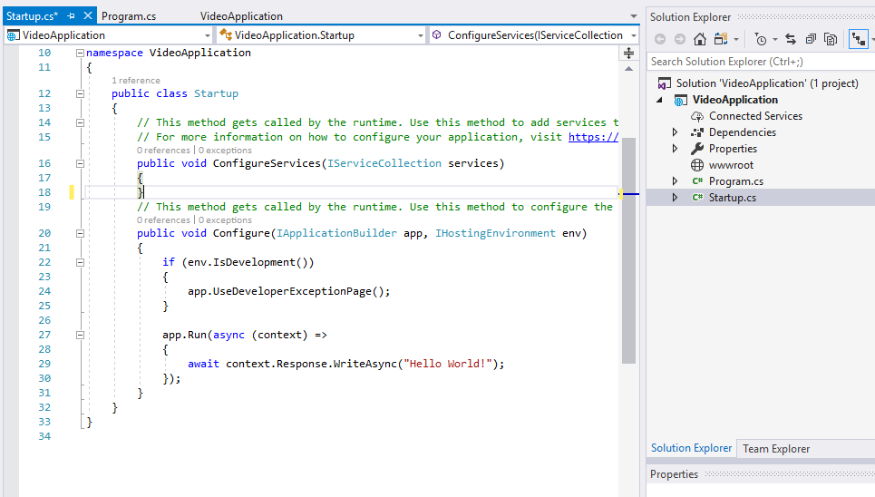
For any request that comes in just write out helloworld

Slide 34
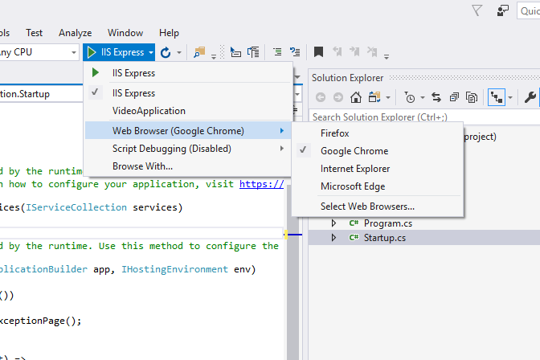

Slide 35
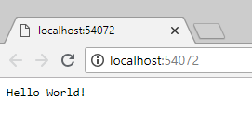
Even if you check view source this is just text
Which we are returning – No html page till now

Slide 36
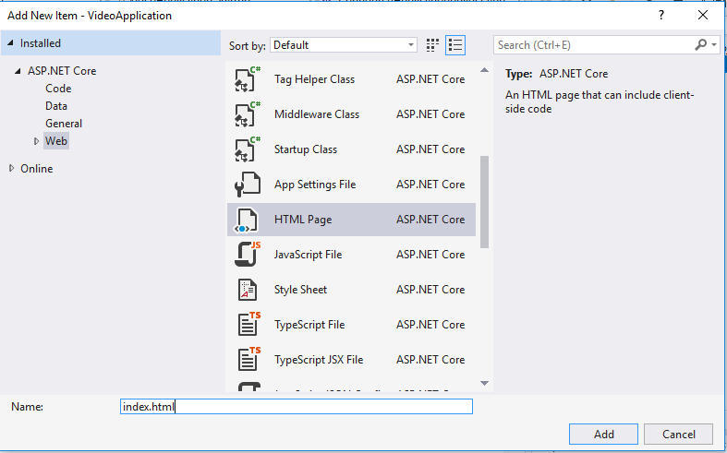

Slide 37
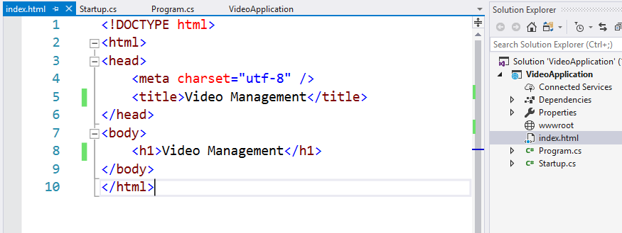

Slide 38
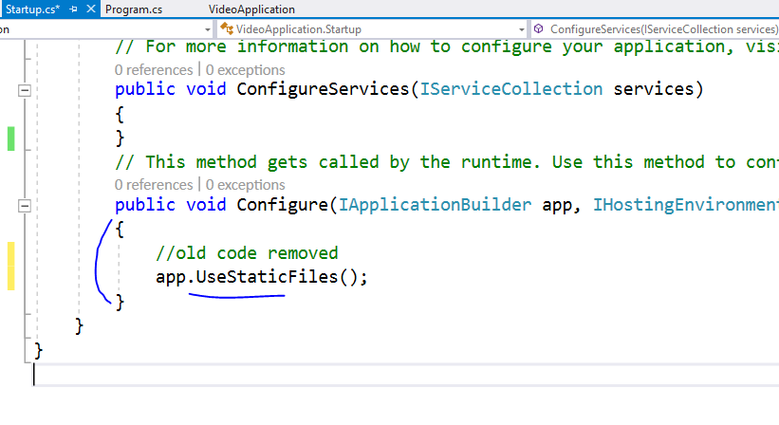

Slide 39
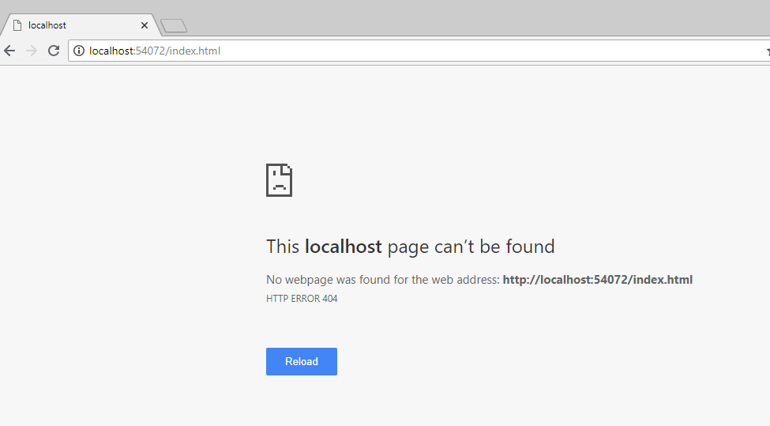
Ooops !!

Slide 41
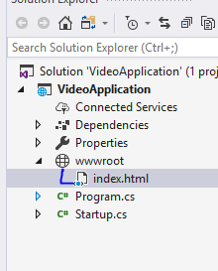
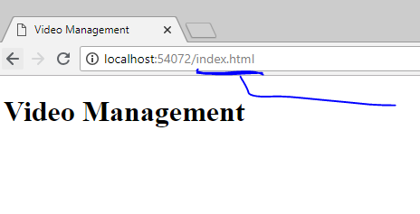
Move index file into wwwroot

Slide 42
All your JS, CSS, HTML and font files will
Always go inside wwwroot folder only

Slide 43
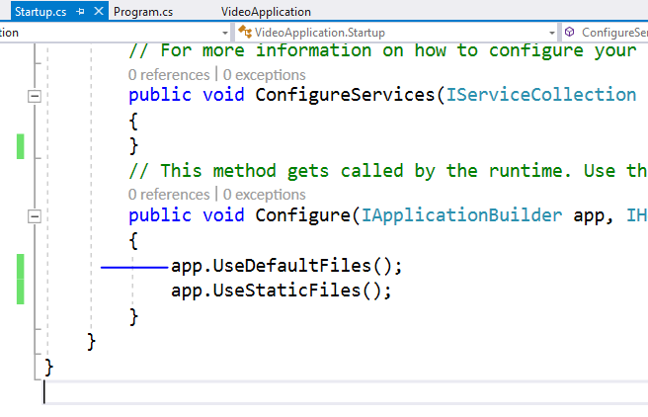
To serve html in this directory please add this
This order is important because
Middleware works based on that

Slide 44
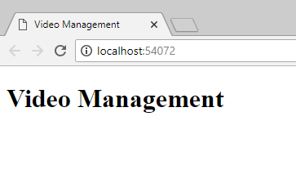
Now index page is visible on base URL

Slide 45
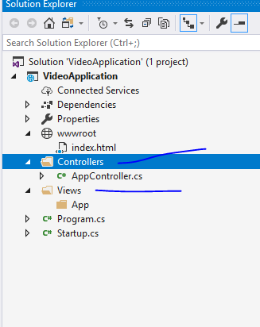
Add folders like this

Slide 46
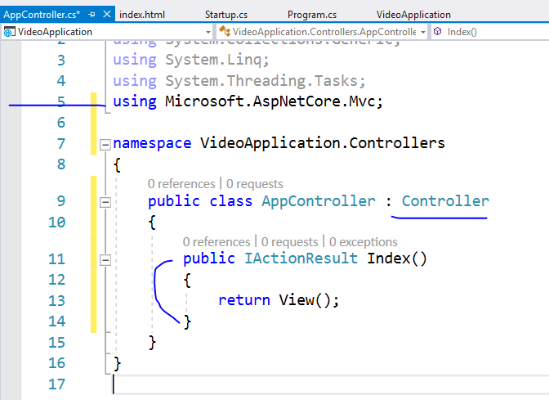
Add code
like this

Slide 47
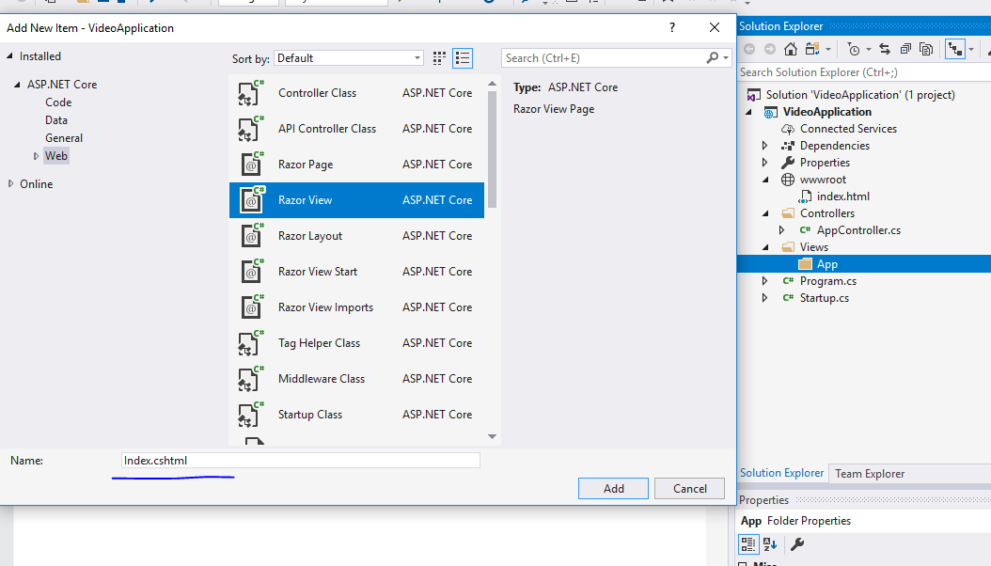

Slide 48
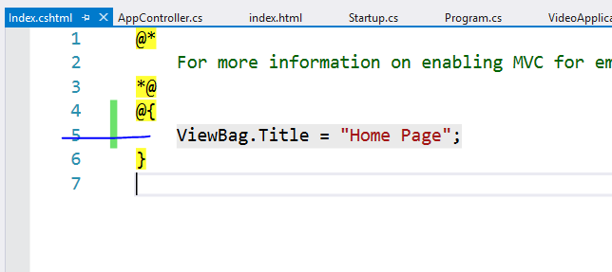

Slide 49
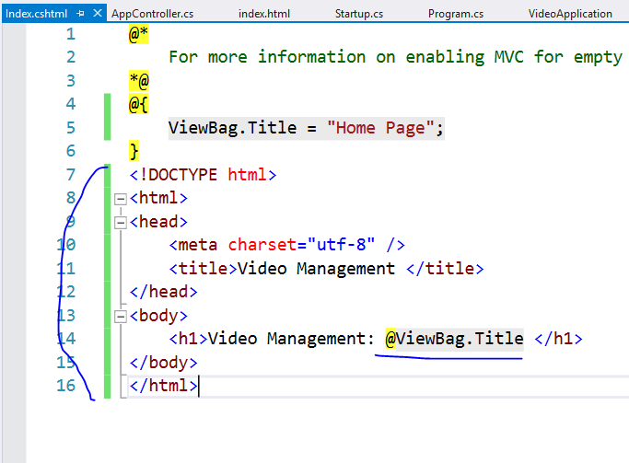

Slide 50
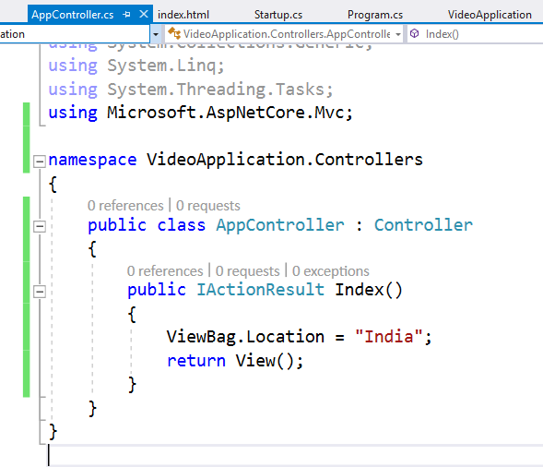

Slide 51
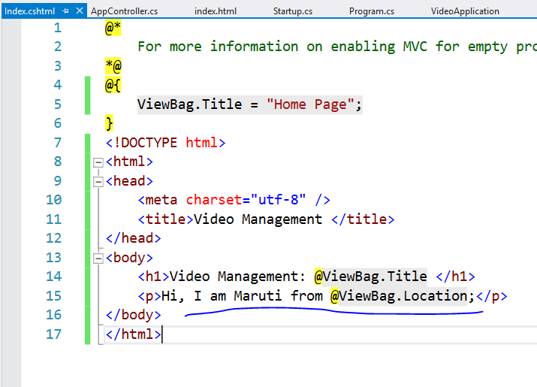

Slide 52
This will not run controller right now
Because we have not enabled MVC in this project
Let’s do it now

Slide 53
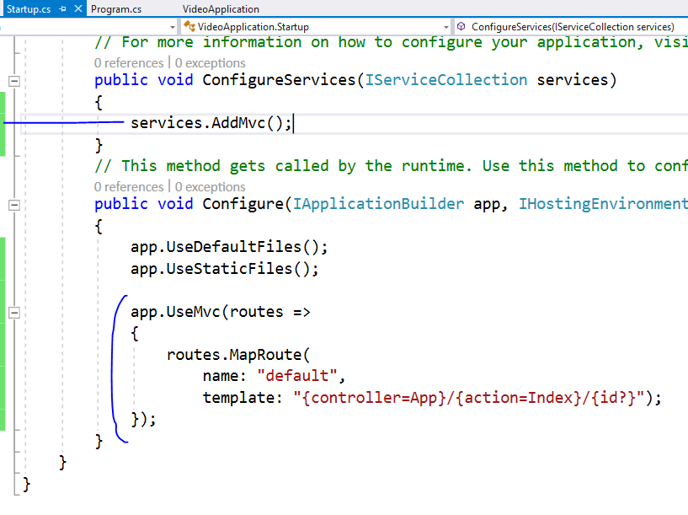

Slide 54
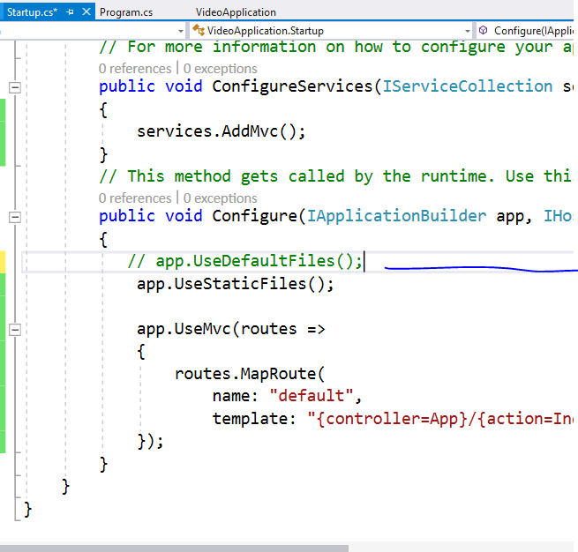
Comment this as
We don’t want to follow
File system path

Slide 55
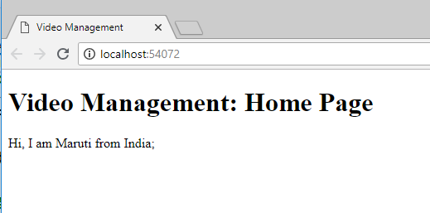

Slide 56
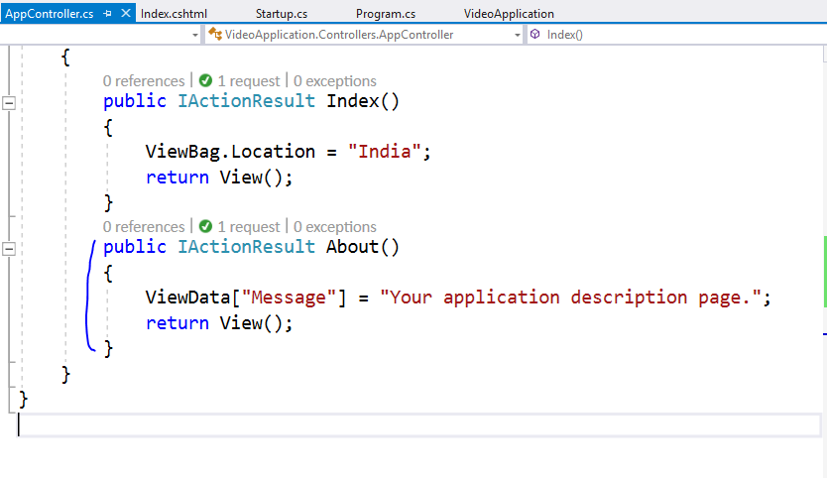

Slide 57
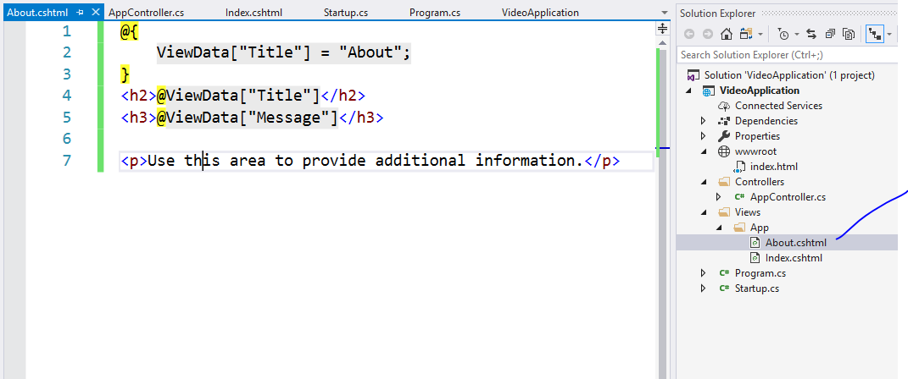

Slide 58
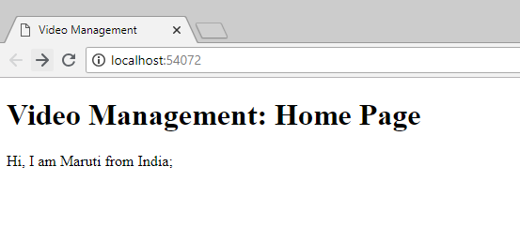
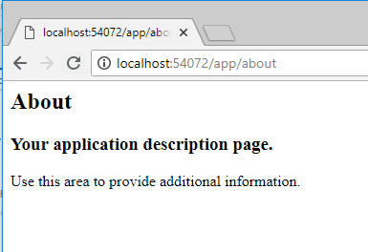
Type this url

Slide 59
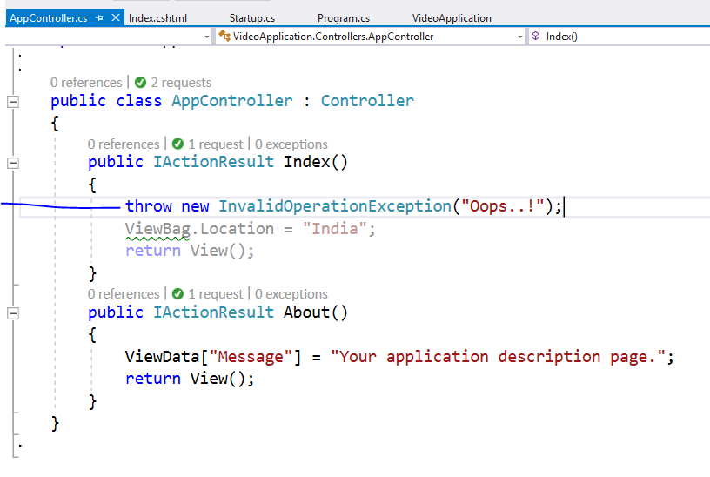
Add this line and run using ctrl + F5

Slide 60
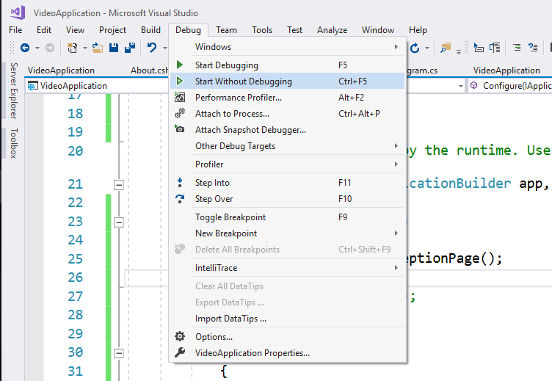

Slide 61
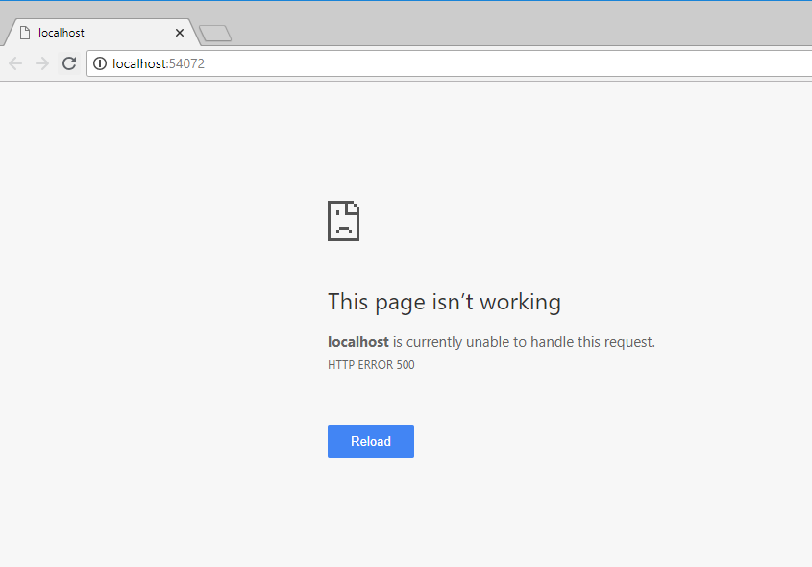
You will not get exception details

Slide 62
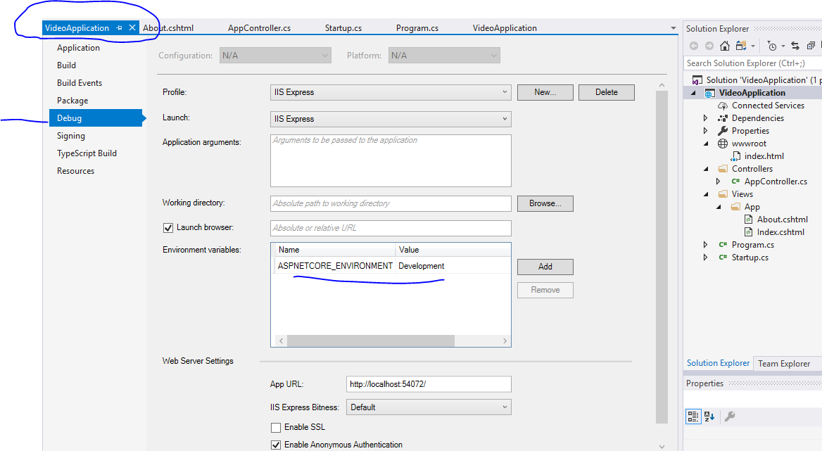

Slide 63
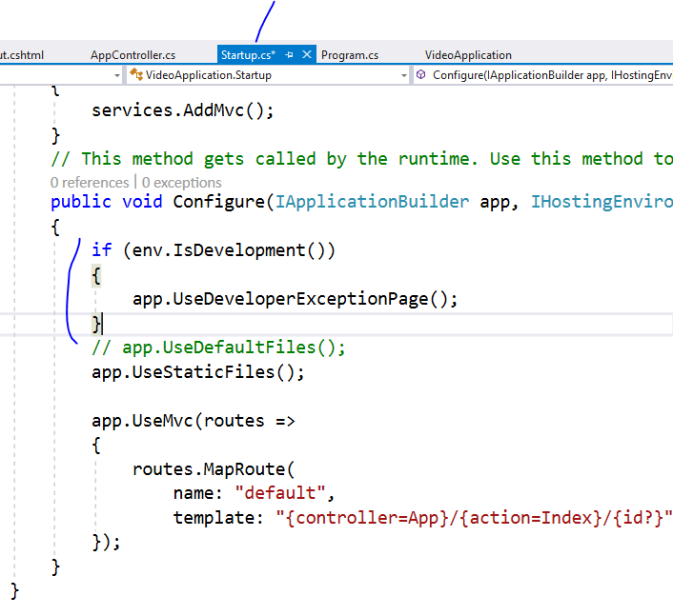

Slide 64


Slide 65


Slide 66


Slide 67


Slide 68


Slide 69

Remove extra things

Slide 70


Slide 71


Slide 72


Slide 73


Slide 74


Slide 75


Slide 76


Slide 77

Whatever you add here will be referred in
All the views

Slide 78


Slide 79


Slide 80


Slide 81


Slide 82


Slide 83


Slide 84

Change it to production

Slide 85
Now we are going to create Razor Page

Slide 86

Add new folder and new page

Slide 87

Pages do not require controllers

Slide 88



Slide 89

We added
2 contact actions

Slide 90


Slide 91


Slide 92


Slide 93





Slide 94


Slide 95


Slide 96



Slide 97


Slide 98
Now lets use tag helpers for same

Slide 99


Slide 100


Slide 101

Even if you click on lable it will
Focus on textbox because of
Asp-for

Slide 105
Validation : skip

Slide 106


Slide 107


Slide 108

If you want to display
Summary on top then
Set
Asp-validation-summary=“All”

Slide 113
S.O.L.I.D Principles
S stands for SRP (Single responsibility principle)
-Concerned about single focused purpose
O stands for OCP (Open closed principle)
-Open for extension but Closed for modification
L stands for LSP (Liskov substitution principle)
-the parent cannot replace the child object seamlessly
I stands for ISP ( Interface segregation principle)
-any Interface should not force any method to class which is implementing it
D stands for DIP ( Dependency inversion principle)
-Objects should be loosely coupled and injection should happen at runtime

